Slide 1


EXPECT THE UNEXPECTED
EMEA MEETING
24626

Slide 2
Why Expect the Unexpected
Next year promises significant changes and challenges in the eyewear industry and within Luxottica, including new technologies, heightened competition, slowing business growth in certain markets, organizational changes. This makes it crucial to establish clear priorities and build a robust support network.
“Expect the Unexpected” will be a three-day meeting designed to equip the EMEA leadership team with the focus, clarity, energy, and motivation needed to tackle these challenges head-on, ready to face whatever comes their way.

Slide 3
Objectives
Refuel with the energy and motivation needed to face the challenges ahead
Align the non-negotiable pillars that will drive the business next year
Translate those pillars into specific actions
Recreate the sense of community, boosting the proactive sharing and support between functions, countries and the entire region

Slide 4

Overview
Day 1:
A very exciting day focused on energizing and engaging the team. Activities will include activities to getting to know each other and increasing the energy level, laying the foundations for the non-negotiables.
Activities:
Icebreaker The Dark Side of the Moon
Group Experience TBD
1/2 day - Afternoon
Day 2:
A deep dive into the non-negotiables and building a sense of community.
This day will be dedicated to aligning the non-negotiable pillars and translating them into specific actions, function by function.
Activities:
Icebreaker Mystery Candies
Metaplan Fly to 2025
Full day
Day 3:
The final day will involve presenting action plans, making commitments and sharing insights, as well as reinforcing the sense of community.
Activities:
Sharing of Mystery Candies
Presentation of the action plans
Individual commitment
Cooperation pledge
½ day - Morning

Slide 5

Day 1 – 14h-18h
Icebreaker – The Dark Side of the Moon
The convention starts with an icebreaker where participants reflect about what’s important for themselves and share it, giving them the opportunity of know each other better.
Participants draw an album cover representing who they are and choose a theme song. They share it in trios.
They then send a photo of their drawing and a link to their song to the cell phone number of one of the facilitators.
At strategic moments throughout the three days, the facilitators will share some of the covers with the songs, and participants try to guess who it is related to.
The person then will have one minute to share their choice.

Slide 6
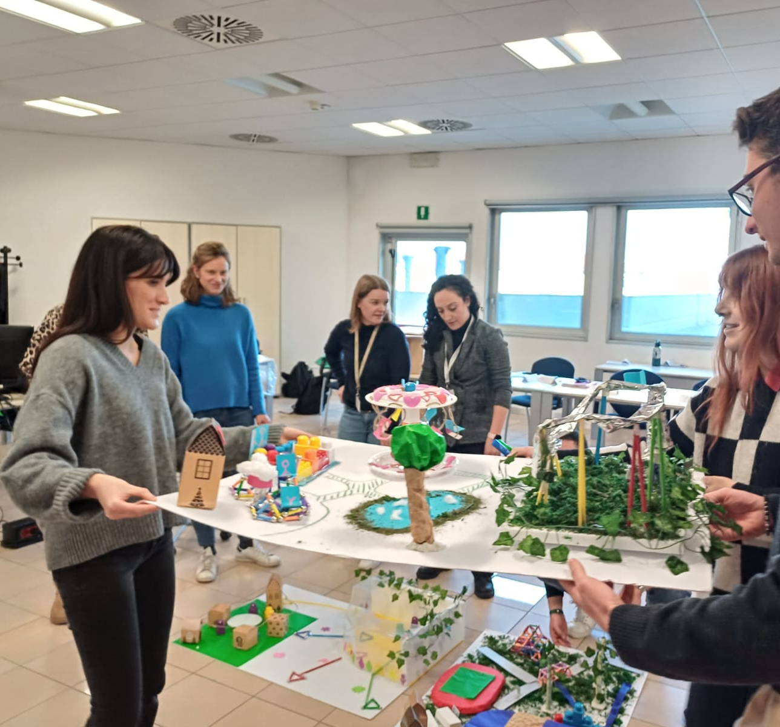
Day 1 – 14h-18h
After the icebreaker, there will be an energizing activity to be chosen between 3 options.
Option 1: EMEApolis
Divided into teams, participants are invested in creating a common project that requires sharing, timely decisions and creative solutions.
Team members are given a mandate by the mayor to build the Ideal City in which they want to live. The subgroups have to build the different neighbourhoods of the city in 3D, one per group, which represent the essential elements for the Team to thrive in the year to come.
In addition, various unexpected setbacks will force the groups to transform the project as it progresses.
A celebration will take place through the assembly of the model, followed by a debrief that helps set the base for the next day.
Skills:
Cross-functional collaboration
Integration between roles
Flexibility with respect to change
Constant alignment
Accountability

Slide 7
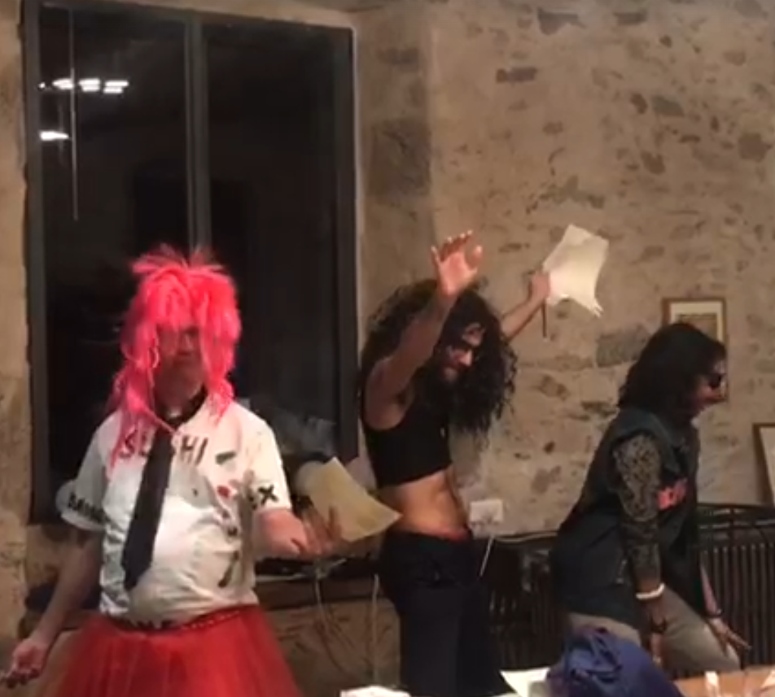
Day 1 – 14h-18h
After the icebreaker, there will be an energizing activity to be chosen between 3 options.
Option 2: EMEA Musical
A creative setting where participants collaborate around a shared goal: the reproduction and reinterpretation of famous musicals. An event filled with suspense, twists and turns, group rehearsals and individual talents.
It is an opportunity to bring hidden talents to the surface, shake up the usual dynamics and enhance mutual understanding. Each group will create a 5 minutes version of famous Broadway show. A series of rehearsals and moments of coordination lead to the grand finale, celebrating this collaborative work.
Certain realization constraints ensure not only the quality of the result, but also participatory ways of realization (e.g., there must be at least two collective choreographies of one minute each in the script, and a singing or acting part).
Skills
Cross-functional collaboration
Common Purpose Orientation: One Team, One Vision
Accountability
Talent enhancement

Slide 8
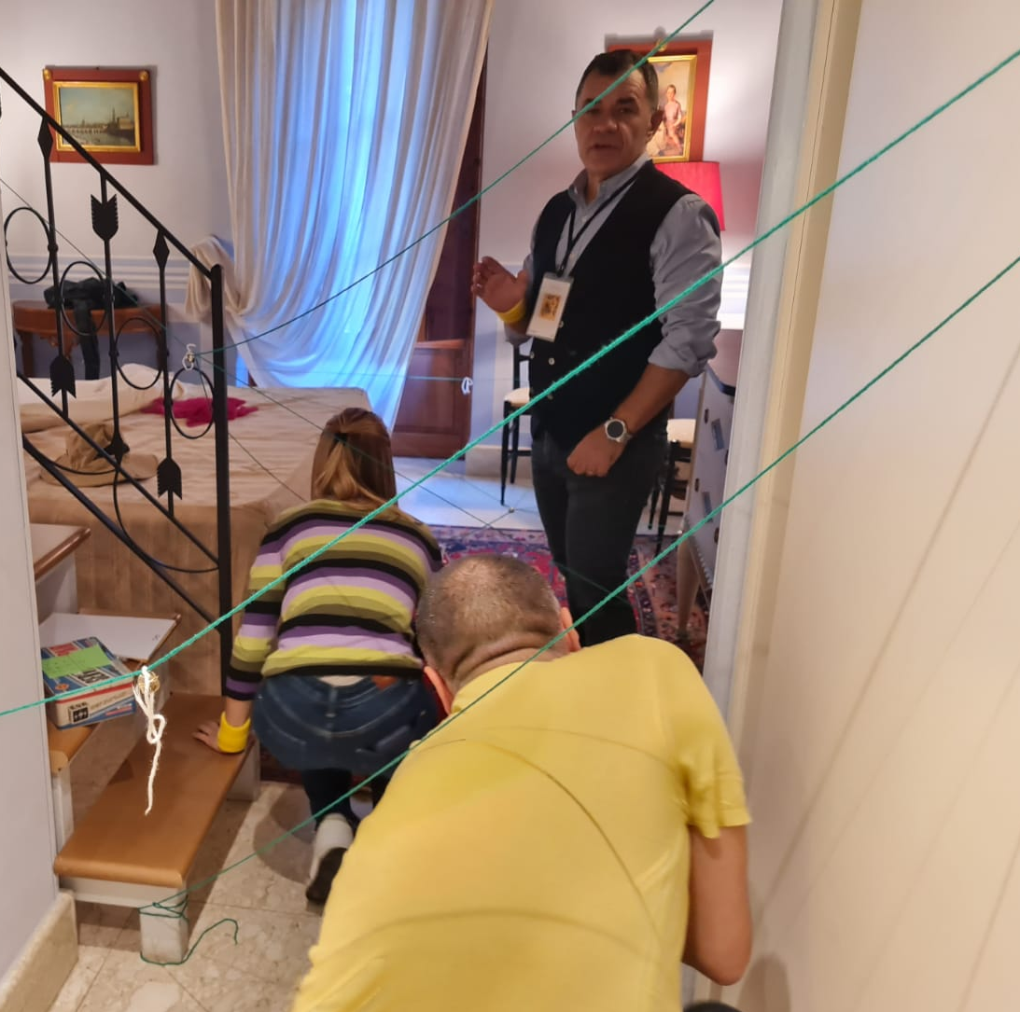
Day 1 – 14h-18h
After the icebreaker, there will be an energizing activity to be chosen between 3 options.
Option 3: EMEAxpedition
Participants are divided into teams to embark on a treasure hunt, navigating through a series of challenges to uncover the next clue. Each successfully completed challenge reveals a numerical value that teams must protect.
While some challenges are tackled in subgroups, there are crucial moments when all teams must collaborate to progress towards the treasure.
The treasure is eventually found and represents the collaboration towards success.
This activity offers a fantastic opportunity for participants to get to know each other, fostering a sense of group cohesion and belonging as they work towards a common goal.
Skills:
Cross-functional cooperation
Changes in perspective and context
Talent enhancement
Accountability
Problem solving

Slide 9
Day 2 – 9h-18h
Icebreaker Mystery Candies
This icebreaker will provoke participants to interact, discover more about each other and reinforce the sense of community.
Participants receive candies whose packaging contain actions aimed at sharing and integration, which must be carried out not only at that moment, but also over the course of the 2nd and 3rd days.
Each time they do one of the actions, they put the package in a jar. Facilitators will read out some of the packages on the last day, an invite participants to share how the experience was.
Examples of actions:
Share with a colleague a situation in which they made a difference to you
Choose a colleague to tell how they could help you in some daily situation
Tell a colleague with whom you interact less about one of your strengths
Share with a colleague what belonging to a team means to you
They will have time to do 1 of the actions during the icebreaker, and then can pick up other candies and do the other actions throughout the convention.

Slide 10
Day 2 – 9h-18h
Metaplan: Fly to 2025
After the icebreaker, we go through a structured process to guide the discussion about the team and the non-negotiables, and how to translate them into specific actions. The entire process lasts all day and is alternated with fun moments of sharing the activity “The Dark Side of The Moon”, inspirational videos and storytelling from facilitators to help bring more clarity.
1. Alignment of the non-negotiables
Divide NN for countries and then for region. After a brief sharing of the pillars for 2025, we ensure the non-negotiables are clear and agreed to everyone.
2. Moonlight and Moon Shadow
Participants discuss about what currently facilitates and what hinders the non-negotiables.
3. Brainstorming
In subgroups focused on each topic, participants brainstorm how to make them alive. A few rounds of brainstorming are done, and participants have the opportunity to discuss other topics (we can have them go around and discuss each topic at a time, going through all of them, or make 2 additional rounds where they can individually choose different topics, so they will discuss it with different people).
4. Action plan
Ideas are organized according to categories and ranked, considering the creativity and feasibility criteria.
Up to 3 ideas are chosen by each group, and they than work on a detailed action plan for each idea. They get prepared to present the action plans the next day.

Slide 11
Day 3 – 9h-13h
Sharing of Mystery Candies
Facilitators take some of the packages in the pot and ask participants to share their experience.
Presentation of the action plans
The groups have 10 minutes each to present the action plans prepared the day before.
Individual Commitments
Each participant share 1 commitment in subgroups, using the 4 phases of the moon as an inspiration:
Full Moon – What I have plenty and I'll keep it
Waning – What I’ll decrease or stop doing
New moon – New behaviours I commit to
Waxing – What I’ll do more often
Cooperation pledge
To close the meeting, each participant is invited to send a message to another participant with a commitment to cooperate, and how they plan to do it.

Slide 12


Fee Plan
PRE DELIVERY ACTIVITIES
Micro-design of the learning process (outline of the event, design of the activities, customized materials, slide deck) Additional micro-design if EMEAxpedition activity is chosen | € 3.600 € 1.800
DELIVERY
Delivery (3 trainers for 1 full day and 2 half days – 60 participants) Game master if EMEAxpedition activity is chosen (game coordination and set up) | € 13.800 (€ 1.800 one day/trainer, 1.400 half a day/trainer) € 1.300
MATERIALS
Production of customized educational materials for Option 1: EMEApolis (cost for 60 participants in 6 groups of 10) Production of customized educational materials for Option 2: EMEA Musical (cost for 60 participants in 6 groups of 10) Production of customized educational materials for Option 3: EMEAxpedition (cost for 60 participants in 6 groups of 10) Shipping | € 2.100 € 3.100 € 1.600 TBD
COSTO TOTALE
Option 1: EMEApolis Option 2: EMEA Musical Option 3: EMEAxpedition | € 19.500 € 20.500 € 22.100
24626

Slide 13
GENERAL CONTRACT CONDITIONS
1. Premise
1.1 Infinity firmly believes in its products and services and strives to fully satisfy its clients. We undertake programmes only if we are convinced of their absolute practicality for the client for whom we strive to achieve total satisfaction.
1.2 The general conditions of the contract listed below form an integral and essential part of the attached Offer.
2. Payments
2.1 Payment is requested at the completion of the activity undertaken or in conformity with the work proceedings duly carried out. Payment must be made in favour of INFINITY S.r.l. by means of bank transfer, to the bank indicated in the invoice, within a maximum of 60 days from the invoice date.
2.2 All costs and rates quoted in this contract are expressed net of VAT, which will be charged at the rate required by law.
2.3 The client consents to the issue, on behalf of Infinity S.r.l, of an invoice via E-mail established in Paragraph 3 of Article 21 of Law 633/72 and by rights set forth in Article 6 of Law 633/7. The documents will be sent via E-mail at the address provided by the client.
3. Expenses
3.1 All expenses connected to the undertaking of the contract in object, including transfers, will be refunded to Infinity S.r.l. An Invoice will be issued, where applicable, including VAT expenses. Documentation of the relevant receipts will be provided.
4. Transfer Fee
4.1 For the delivery of courses or consulting services outside Europe, the costs of additional man/days due to the transfer will be charged based on the destination.
5. Saturday and Holiday Work
5.1 Rates shall be increased by 20% for courses and consulting on Saturdays, Sundays and holidays.
6. Didactic Material
6.1 Didactic material is determined according to the number of participants indicated by the Client.
6.2 The cost of the didactic material is calculated according to the previous Article 6.1 and is to be considered obligatory and to be covered by the client. The client agrees that should the number of participants be inferior to the number initially communicated, the entire cost of the material is required in accordance to Article 6.1.
6.3 In the eventuality that the number of participants is higher than the number initially indicated the cost of the didactic material will be increased according to the number of participants.
7. Cancellations
7.1 In the eventuality of cancellations or postponing scheduled courses of the contract:
- within 14 days prior to the scheduled start of the course, the contracting part shall pay INFINITY S.r.l. 50% of the cost of the cancelled course.
- within 7 days prior to the start of the course, the contracting party shall pay INFINITY S.r.l. the entire amount of the course.
8. Industrial and Intellectual Property
8.1 The contracting party acknowledges, for itself and its employees, that courses and supporting materials are the property of Infinity.
8.2 It is therefore prohibited to copy the materials and disseminate the total or partial content of any teaching unit without the prior written authorization of Infinity.
9. Confidentiality
9.1 All the information received by INFINITY S.r.l. from the contracting party, or which emerges in relation to the courses, shall remain strictly confidential.
9.2 Infinity S.r.l. undertakes to adopt all the precautions with its collaborators necessary to protect the confidentiality of said information.
9.3 The client agrees not to reveal or propagate under any circumstance to third parties of any type of information pertaining to Infinity S.r.l. which they have come to know through due course of services delivered.
24626

Slide 14
10. Protection of Personal Data
10.1 All parties reciprocally declare to have come into possession of data shared directly or via third parties, also verbally, that are considered “personal or sensitive data” by UE Regulation 2016/679 (known as GDPR) and to be informed (and, where appropriate, to expressly consent) that the “personal or sensitive data” that was provided, even verbally for pre-contractual purposes or in any case gathered due to the undertaking of the current contract will be used solely for contractual purposes by means of consultation, elaboration, interconnection, comparison with other data and/or any further elaboration manual and/or electronic or of any other kind, for statistical purposes, data will be treated guaranteeing anonymity, by means of communication with public entities, should it be requested for the pursuit of institutional purposes, finally private subjects, when the object os the request is compatible with the institutional ones of Infinity S.r.l.
10.2 All Parties declare to be aware of articles 13 and 14 of the UE Regulation 2016/679 regarding privacy and personal data and declare that they have mutually been informed of what data will be used and all of the factors qualifying its use and that, in all circumstances, the use of this data will be in accordance with principles of propriety, lawfulness, transparency and protection of confidentiality and of the rights of the affected parties.
11. Domicile of Choice
11.1 For all communications related to the present agreement, the parties must select a domicile where all related correspondence is to be sent.
The parties selected the following domiciles:
- Infinity S.r.l.: Via Flaminia 1801 – 00188 Roma – fax06/33221858
- Client:_______________________________________________________________
11.2 The parties agree to promptly advise Infinity S.r.l. in the event of any changes to the selected domicile.
12. Validity
12.1 This proposal shall be valid for 90 days from the date indicated.
12.2 If At the end of the period a formal acceptance is not received on behalf of the client, the current proposal is to be considered void and not binding for parties.
13. Supplementary Rules
13.1 Any modification and/or integration to the general conditions of contract of the Offer will have to be made in writing otherwise void.
14. Legal Jurisdiction
14.1 The present contractual agreement conforms to the laws of the Italian Republic.
14.2 For any controversies arising with regard to the interpretation and/or execution of the this agreement, the courts of Rome shall have exclusive jurisdiction.
15. Registration
15.1 This private contract will be registered only in case of non-fulfillment by one of the parties and the relevant cost will be charged to the defaulting party.
08/10/2024
______________________
I N F I N I T Y s.r.l. EssilorLuxottica
________________________ ______________________
Guido Anibaldi (Signature & Stamp)
In compliance with Art. 1341 § 2 of the Italian Civil Code, Clause 2 (Cancellations) of the Annex ‘A’ (General Conditions) attached hereto is hereby specifically approved of and agreed upon.
EssilorLuxottica
______________________
(Signature & Stamp)
24626

